Slide 1
Identification of Best Sellers in FT and NFT product categories

Slide 2
Best Sellers – HP Men’s Closed
Article Number – 824-6503 | Article name – HPO2 Flex
Upper | Genuine Leather
Lining | Sheep + Lycra
Insocks | Memory Foam
Sole | Polyurethane
Sizes | 6-10
Design | Derby Lace up
MRP | 2999.00

Slide 3
Best Sellers – HP Men’s Closed
Article Number – 854-6604 | Article name – HPO2 Flex
Upper | Genuine Leather
Lining | Leather + Lycra
Insocks | Memory Foam
Sole | Polyurethane
Sizes | 6-10
Design | Slip on
MRP | 2999.00

Slide 4
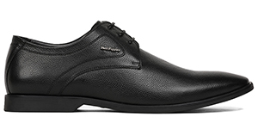
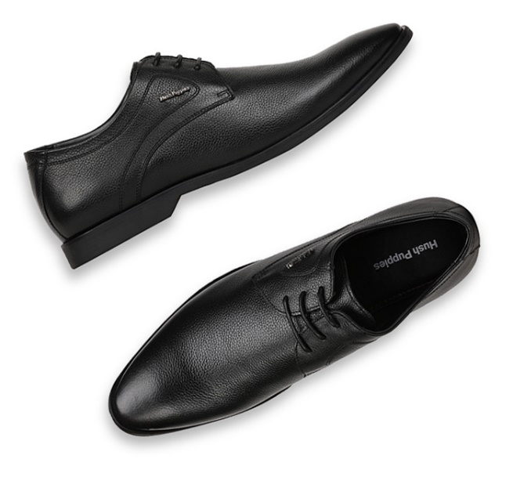
Best Sellers – HP Men’s Closed
Article Number – 824-6872 | Article name – Aaron Derby
Upper | Genuine Leather
Lining | Lycra
Insocks | Latex
Sole | TPR
Sizes | 6-10
Design | Derby
MRP | 2999.00

Slide 5
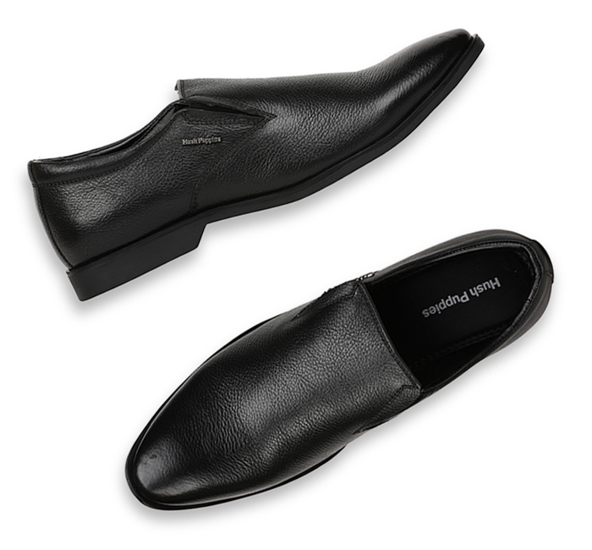
Best Sellers – HP Men’s Closed
Article Number – 854-6873 | Article name – Aaron Plain Slip on
Upper | Genuine Leather
Lining | Lycra
Insocks | Latex
Sole | TPR
Sizes | 6-10
Design | Slip on
MRP | 2999.00

Slide 6
Best Sellers – HP Men’s Closed
Article Number – 824-6854 | Article name – Taylor Lace up
Upper | Genuine Leather
Lining | Leather Lining
Insocks | PU
Sole | TPR
Sizes | 6-10
Design | Derby Lace up
MRP | 3499.00

Slide 7
Best Sellers – HP Men’s Closed
Article Number – 854-4/6866 | Article name – Taylor Slip on
Upper | Genuine Leather
Lining | Leather Lining
Insocks | PU
Sole | TPR
Sizes | 6-10
Design | Slip on
MRP | 3499.00

Slide 8
Best Sellers – HP Men’s Closed
Article Number – 854-6732 | Article name – Boston Slip on
Upper | Genuine Leather
Lining | Leather Lining
Insocks | Dual Density latex
Sole | TPR
Sizes | 6-10
Design | Slip on
MRP | 3499.00

Slide 9
Best Sellers – HP Men’s Closed
Article Number – 824-6732 | Article name – Boston Derby
Upper | Genuine Leather
Lining | Leather Lining
Insocks | Dual Density latex
Sole | TPR
Sizes | 6-10
Design | Derby laceup
MRP | 3499.00

Slide 10
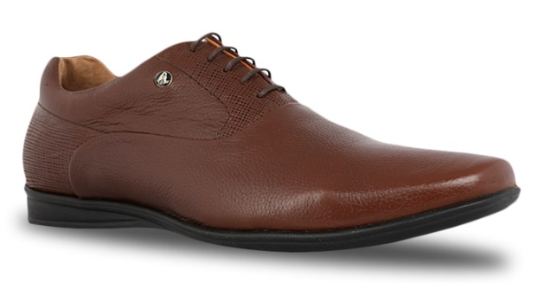
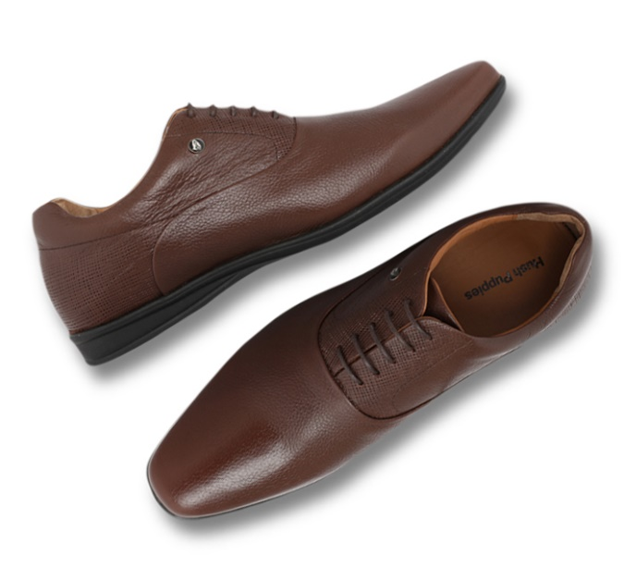
Best Sellers – HP Men’s Closed
Article Number – 824-4/6773 | Article name – Corso Oxford
Upper | Genuine Leather
Lining | Leather Lining
Insocks | Leather
Sole | TPR
Sizes | 6-10
Design | Oxford lace up
MRP | 3999.00

Slide 11
Best Sellers – HP Men’s Closed
Article Number – 854-6734 | Article name – Corso Loafer
Upper | Genuine leather
Lining | Leather Lining
Insocks | Leather
Sole | TPR
Sizes | 6-10
Design | Slip on
MRP | 3999.00

Slide 12
Best Sellers – HP Men’s Closed
Article Number – 854-6724 | Article name – Mocca Zero G
Upper | Genuine Leather
Lining | Leather Lining
Insocks | Leather laminated with 4mm HD Foam
Sole | EVA
Sizes | 6-10
Design | Slip on
MRP | 3699.00

Slide 13
Best Sellers – HP Men’s Closed
Article Number – 824-6727 | Article name – Mocca Zero G
Upper | Genuine Leather
Lining | Leather Lining
Insocks | Leather Laminated with 4mm HD Foam
Sole | EVA
Sizes | 6-10
Design | Derby Lace up
MRP | 3699.00

Slide 14
Best Sellers – HP Men’s Closed
Article Number – 854-3721 | Article name – Cash
Upper | Genuine leather
Lining | Leather
Insocks | Latex
Sole | Rubber
Sizes | 6-10
Design | Slip on
MRP | 3499.00

Slide 15
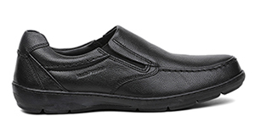
Best Sellers – HP Men’s Closed
Article Number – 854-6714 | Article name – Millions Slip on
Upper | Genuine Leather
Lining | Leather Lining
Insocks | Leather
Sole | Rubber
Sizes | 6-10
Design | Slip on
MRP | 3999.00

Slide 16
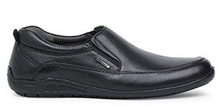
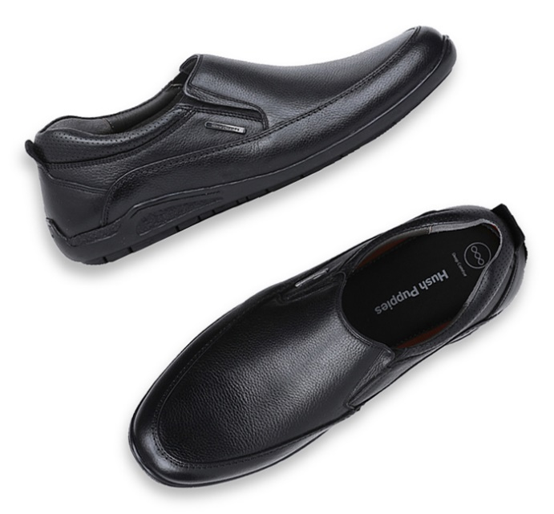
Best Sellers – HP Men’s Closed
Article Number – 854-6718 | Article name – Adrian Slip on
Upper | Genuine Leather
Lining | Leather
Insocks | Dual Density
Sole | TPR
Sizes | 6-10
Design | Slip on
MRP | 3499.00

Slide 17
Best Sellers – HP Men’s Open
Article Number – 864-4/6935 | Article name – Charles Fishermen
Upper | Genuine Leather
Lining | Skin fit – 4mm Foam
Insocks | Leather + Polyfoam-8 mm + HPO2(EVA) 4mm
Sole | Polyurethane
Sizes | 6-10
Design | Sandal
MRP | 2999.00

Slide 18
Best Sellers – HP Men’s Open
Article Number – 863-5/9904 | Article name – Miles Fishermen
Upper | Genuine Oily leather
Lining | Skin fit – 4mm Foam
Insocks | Leather + Polyfoam-8 mm + HPO2(EVA) 4mm
Sole | Polyurethane
Sizes | 6-10
Design | Sandal
MRP | 2999.00

Slide 19
Best Sellers – HP Men’s Open
Article Number – 864-4/6970 | Article name – New Track Fishermen
Upper | Genuine Leather
Lining | Lycra
Insocks | Polyfoam + Memory cushion
Sole | Polyurethane
Sizes | 6-10
Design | Sandal
MRP | 2999.00

Slide 20
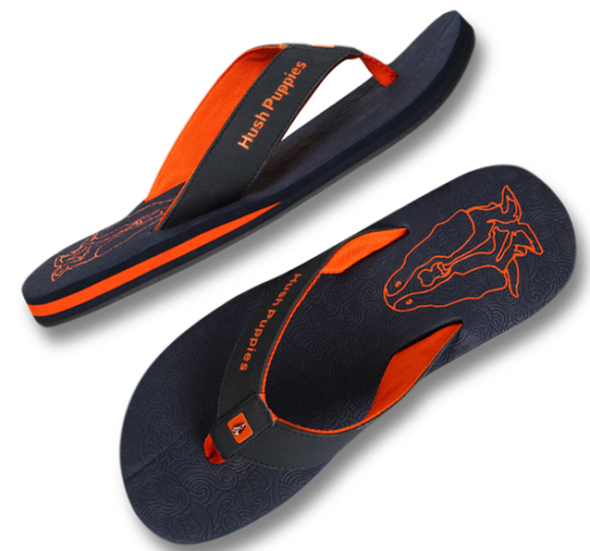
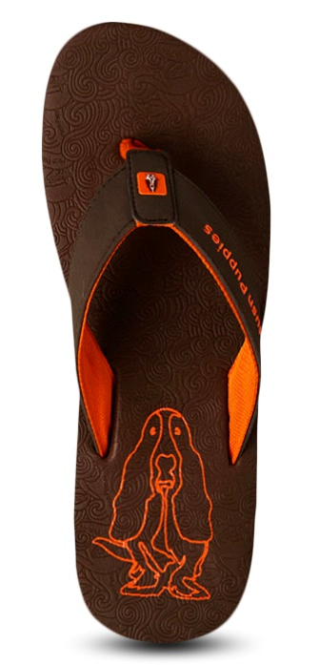
Best Sellers – HP Men’s Open
Article Number – 871-4/9981 | Article name – Vector
Upper | Synthetic
Lining | EVA
Insocks | EVA
Sole | TPR
Sizes | 6-10
Design | Chappal
MRP | 999.00

Slide 21
Best Sellers – HP Men’s Open
Article Number – 874-4/9968 | Article name – Mandy
Upper | Genuine Oily Leather
Lining | Textile Microfiber
Insocks | EVA Footbed
Sole | TPR
Sizes | 6-10
Design | Chappal
MRP | 1499.00

Slide 22
Best Sellers – HP Men’s Open
Article Number – 874-4/6907 | Article name – Charles Thong
Upper | Genuine Leather
Lining | Skin Fit – 4mm
Insocks | Leather + Polyfoam-8 mm + HPO2(EVA) 4mm
Sole | Polyurethane
Sizes | 6-10
Design | Chappal
MRP | 1999.00

Slide 23
Best Sellers – HP Men’s Open
Article Number – 874-4/6952 | Article name – Charles Toe Ring
Upper | Genuine leather
Lining | Skin Fit – 4mm
Insocks | Leather + Polyfoam-8 mm + HPO2(EVA) 4mm
Sole | Polyurethane
Sizes | 6-10
Design | Chappal
MRP | 2499.00

